Slide 1

Sensor Processor
Behind the scenes

Slide 2
Challenges and solutions,
Dealing with stream processing at scale

Slide 3
Challenge: Avoid excessive DB reads

Slide 4

Request
Request
Request
Read
Write
Read
Write
Read
Write
Stateless Service
Source of truth

Slide 5
Request
Request
Request
Write
Write
Write
Stateful Actor
Source of truth
Never interact with the DB from elsewhere

Slide 6

Request
Request
Request
Write
Write
Write
Stateful Actor
Source of truth

Slide 7
Challenge: Concurrency management

Slide 8
Process many messages for different entities in parallel

Slide 9
Process many messages for different entities in parallel
1
2
3

Slide 10
Process many messages for different entities in parallel
1
2
Process one message at a time per entity
3

Slide 11
Challenge: Avoid network hops

Slide 12
Kafka

Slide 13
Kafka

Slide 14
Solution: Local Affinity

Slide 15
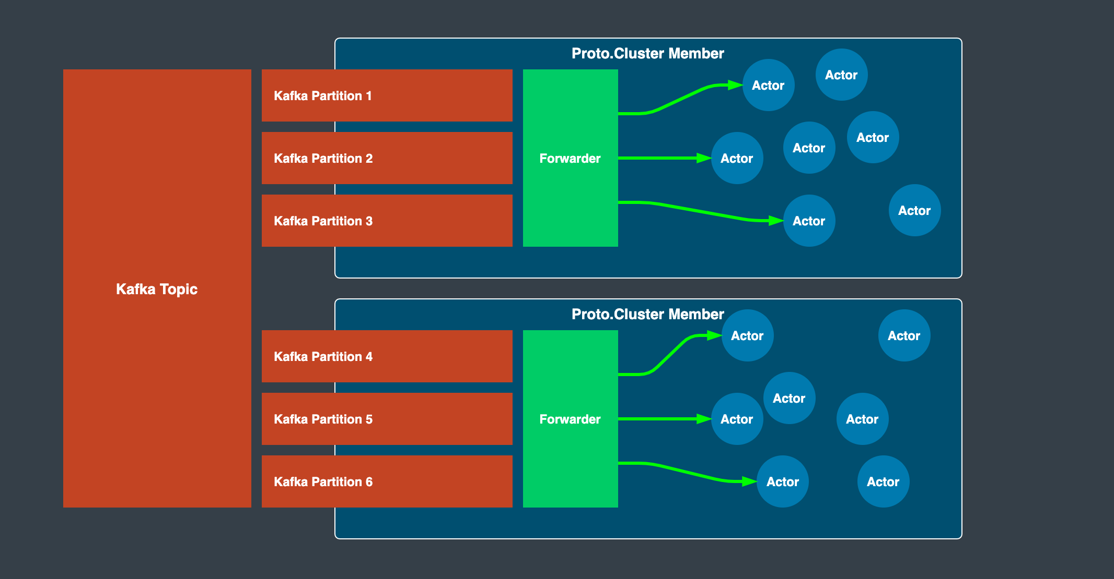

Slide 16
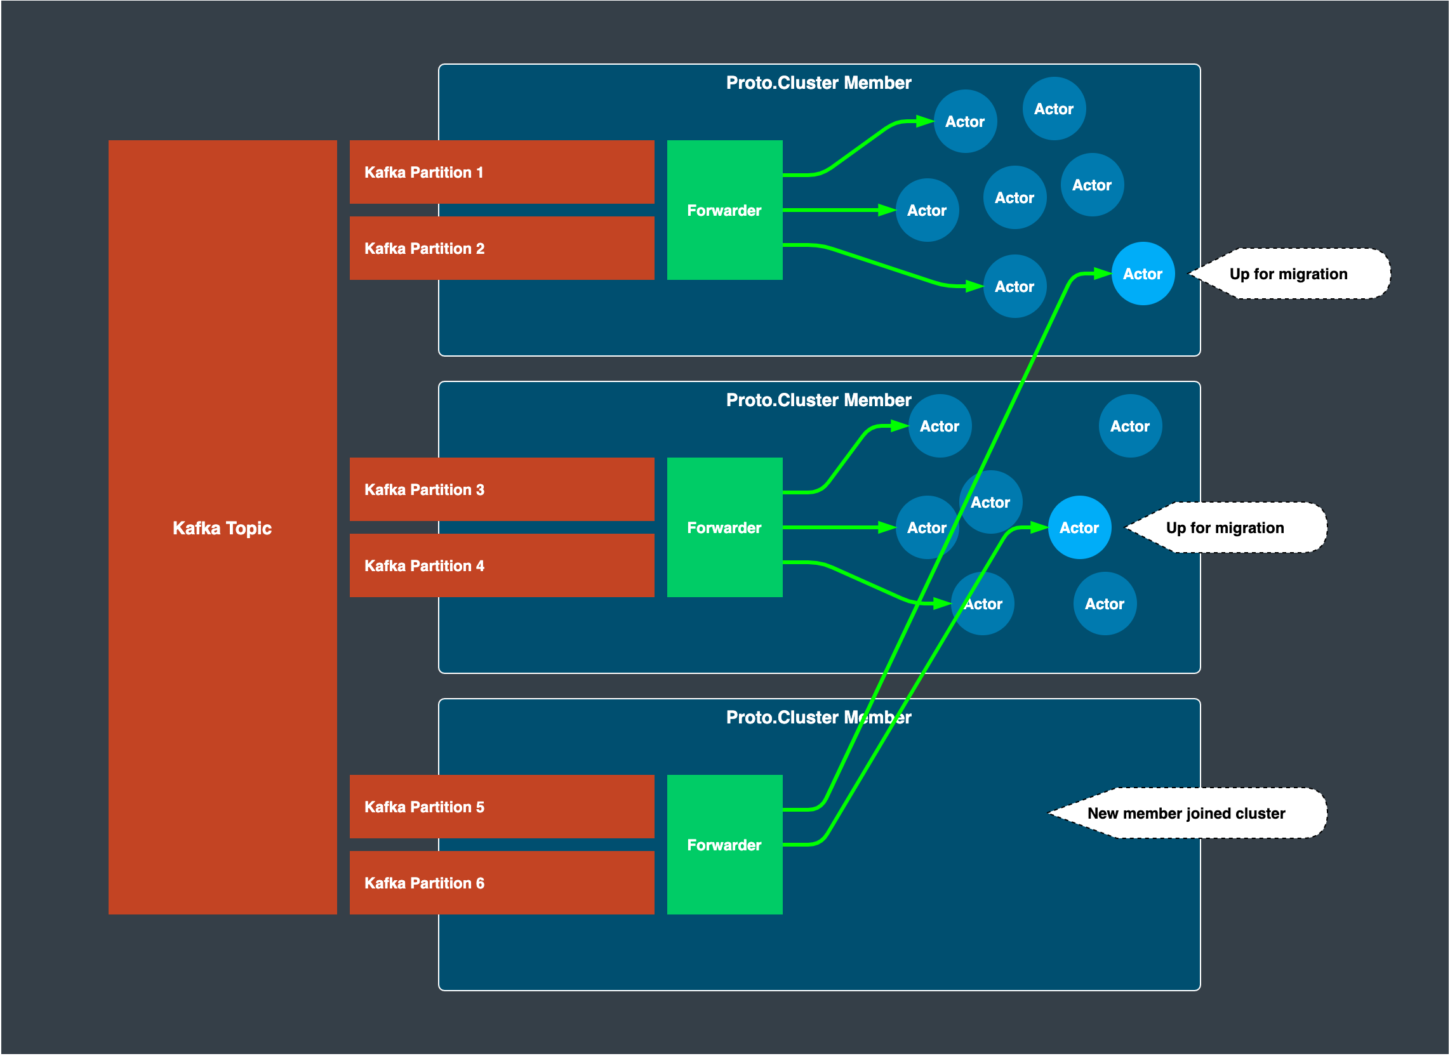

Slide 17
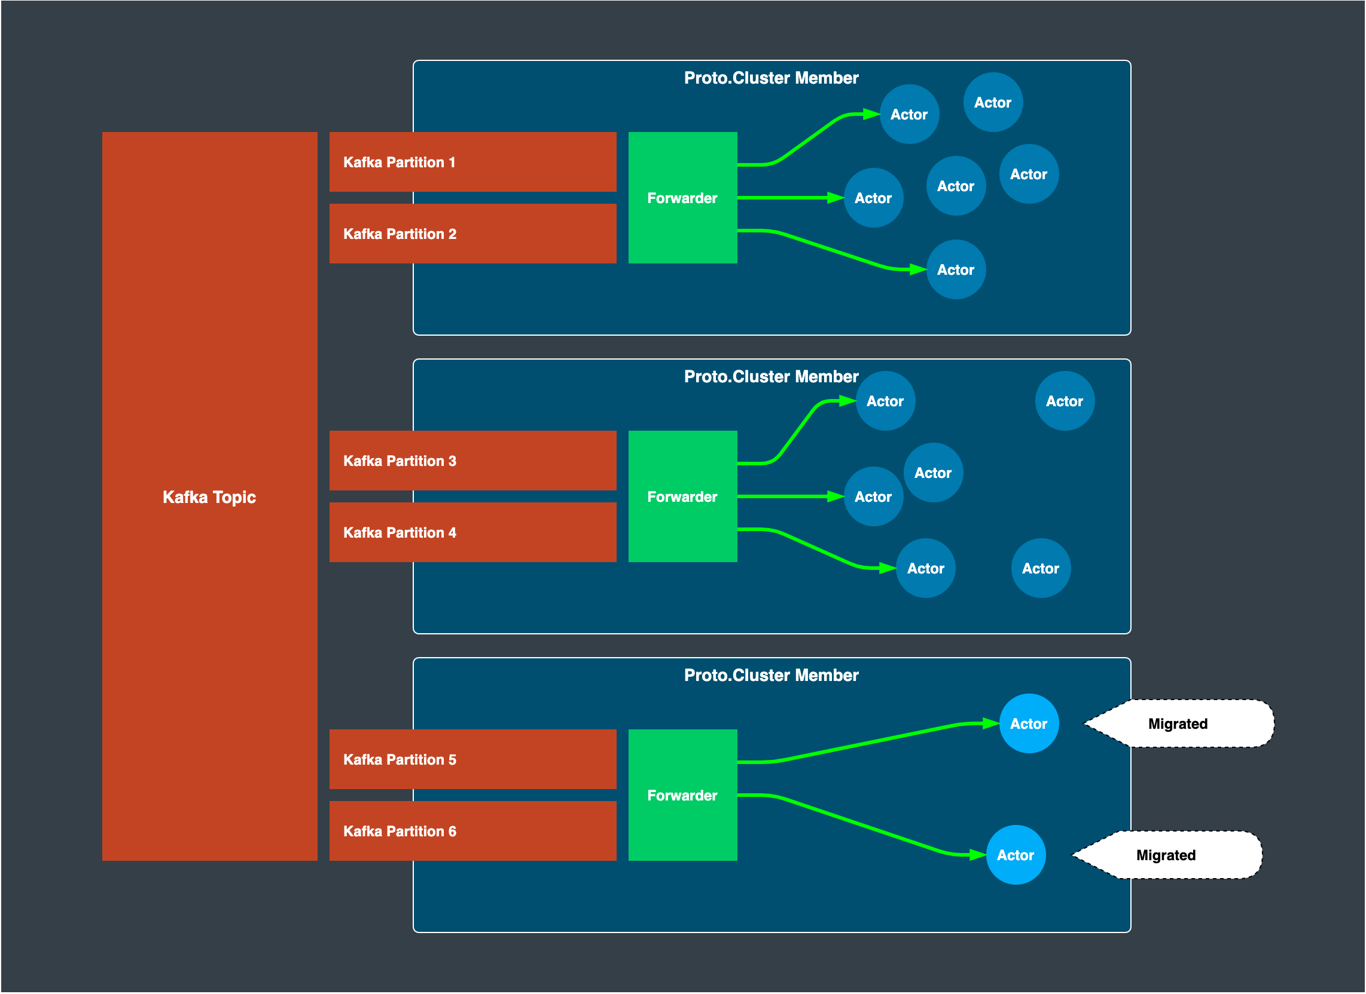

Slide 18
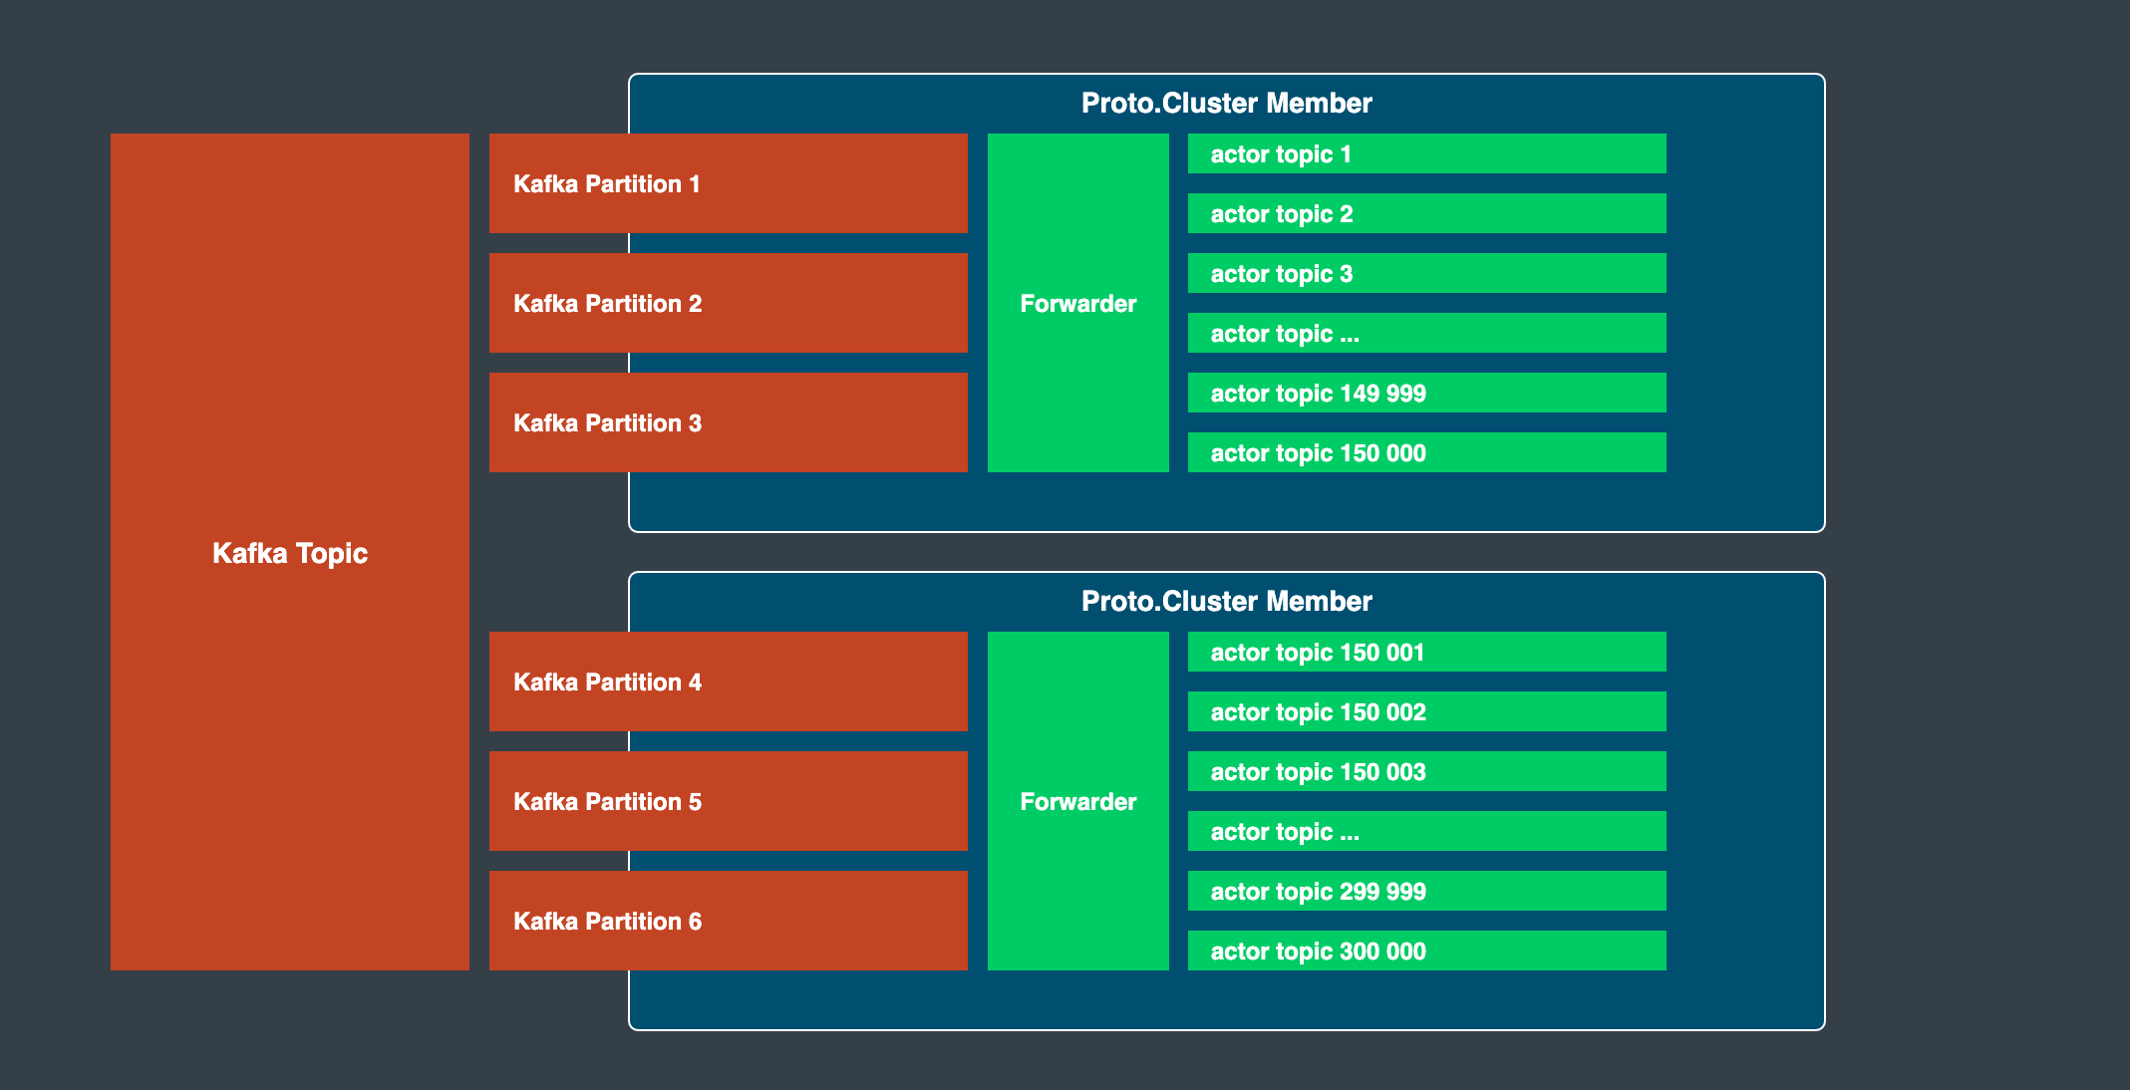

Slide 19
Challenge: Avoid excessive DB writes

Slide 20
Request
Request
Request
Write
Write
Write
Stateful Actor

Slide 21
Request
Request
Request
Write
Stateful Actor

Slide 22
Request
Request
Request
Write
Stateful Actor

Slide 23
Solution: Envelope Pattern

Slide 24
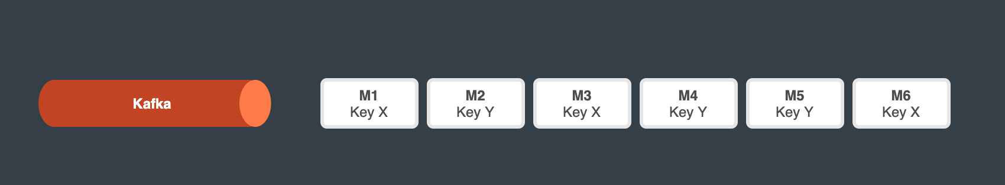

Slide 25
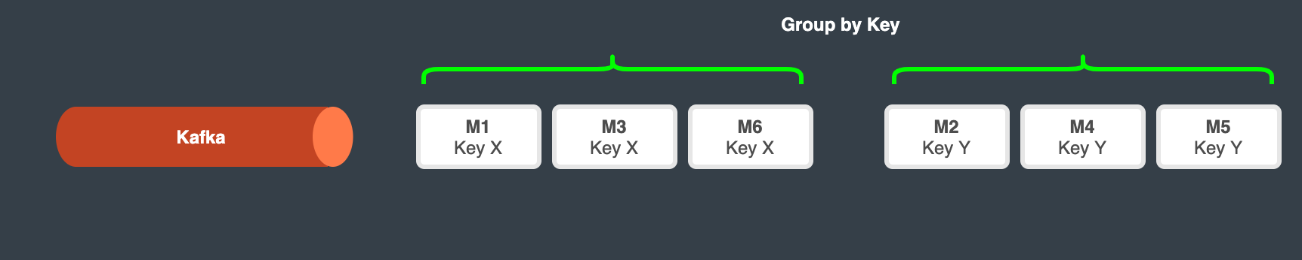

Slide 26
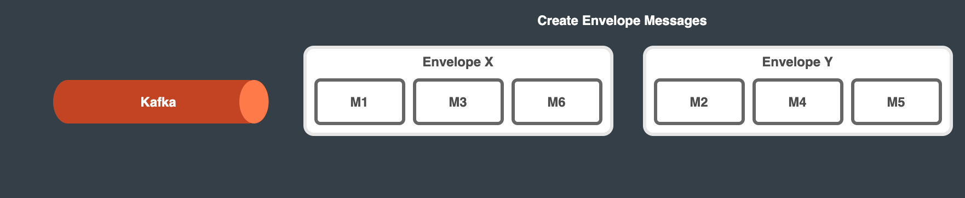

Slide 27
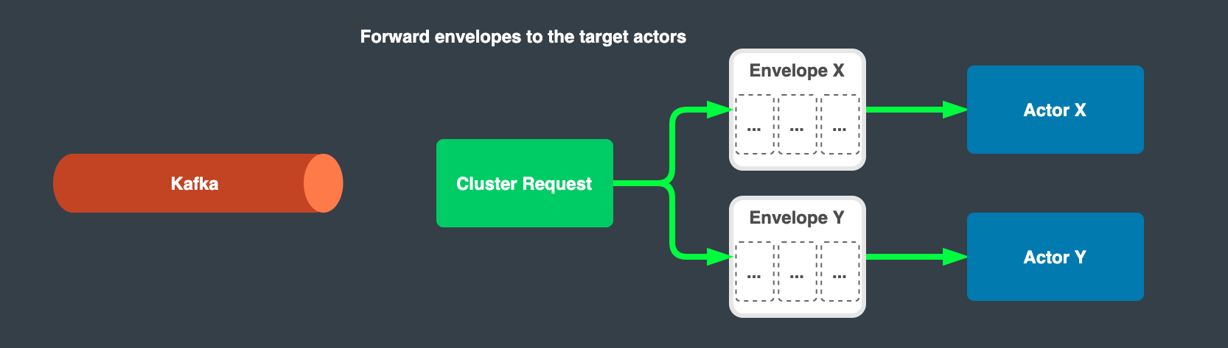

Slide 28
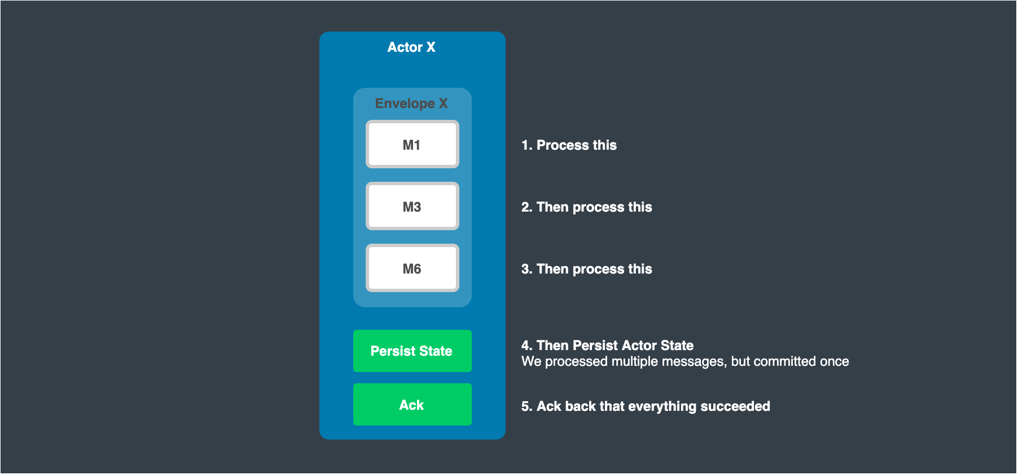

Slide 29
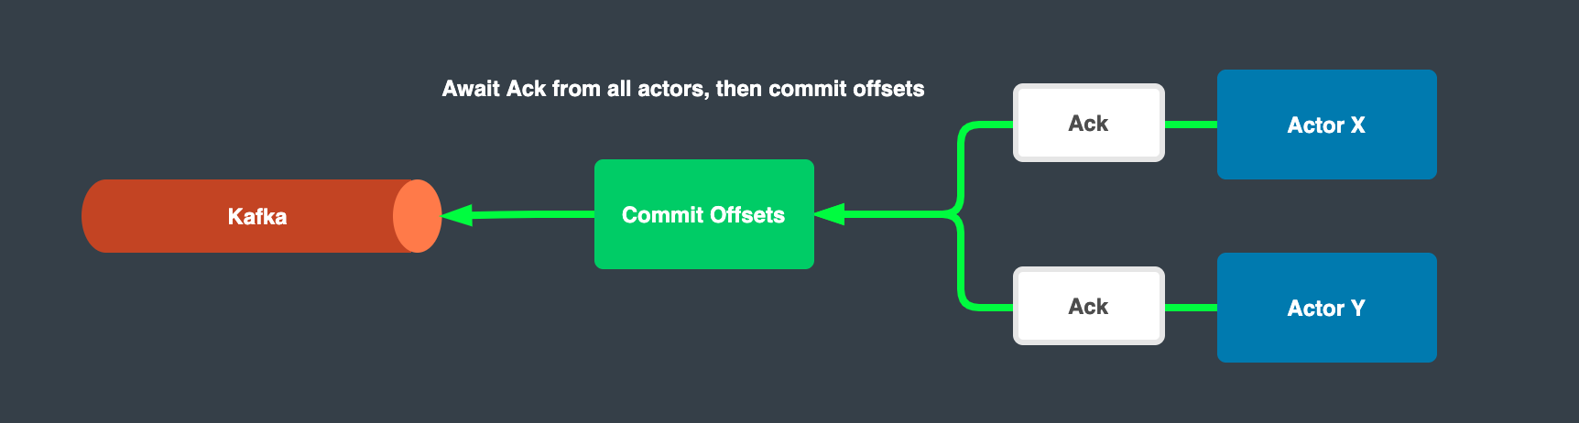

Slide 30
Realtime Streams

Slide 31
Challenge: Limit events processed

Slide 32
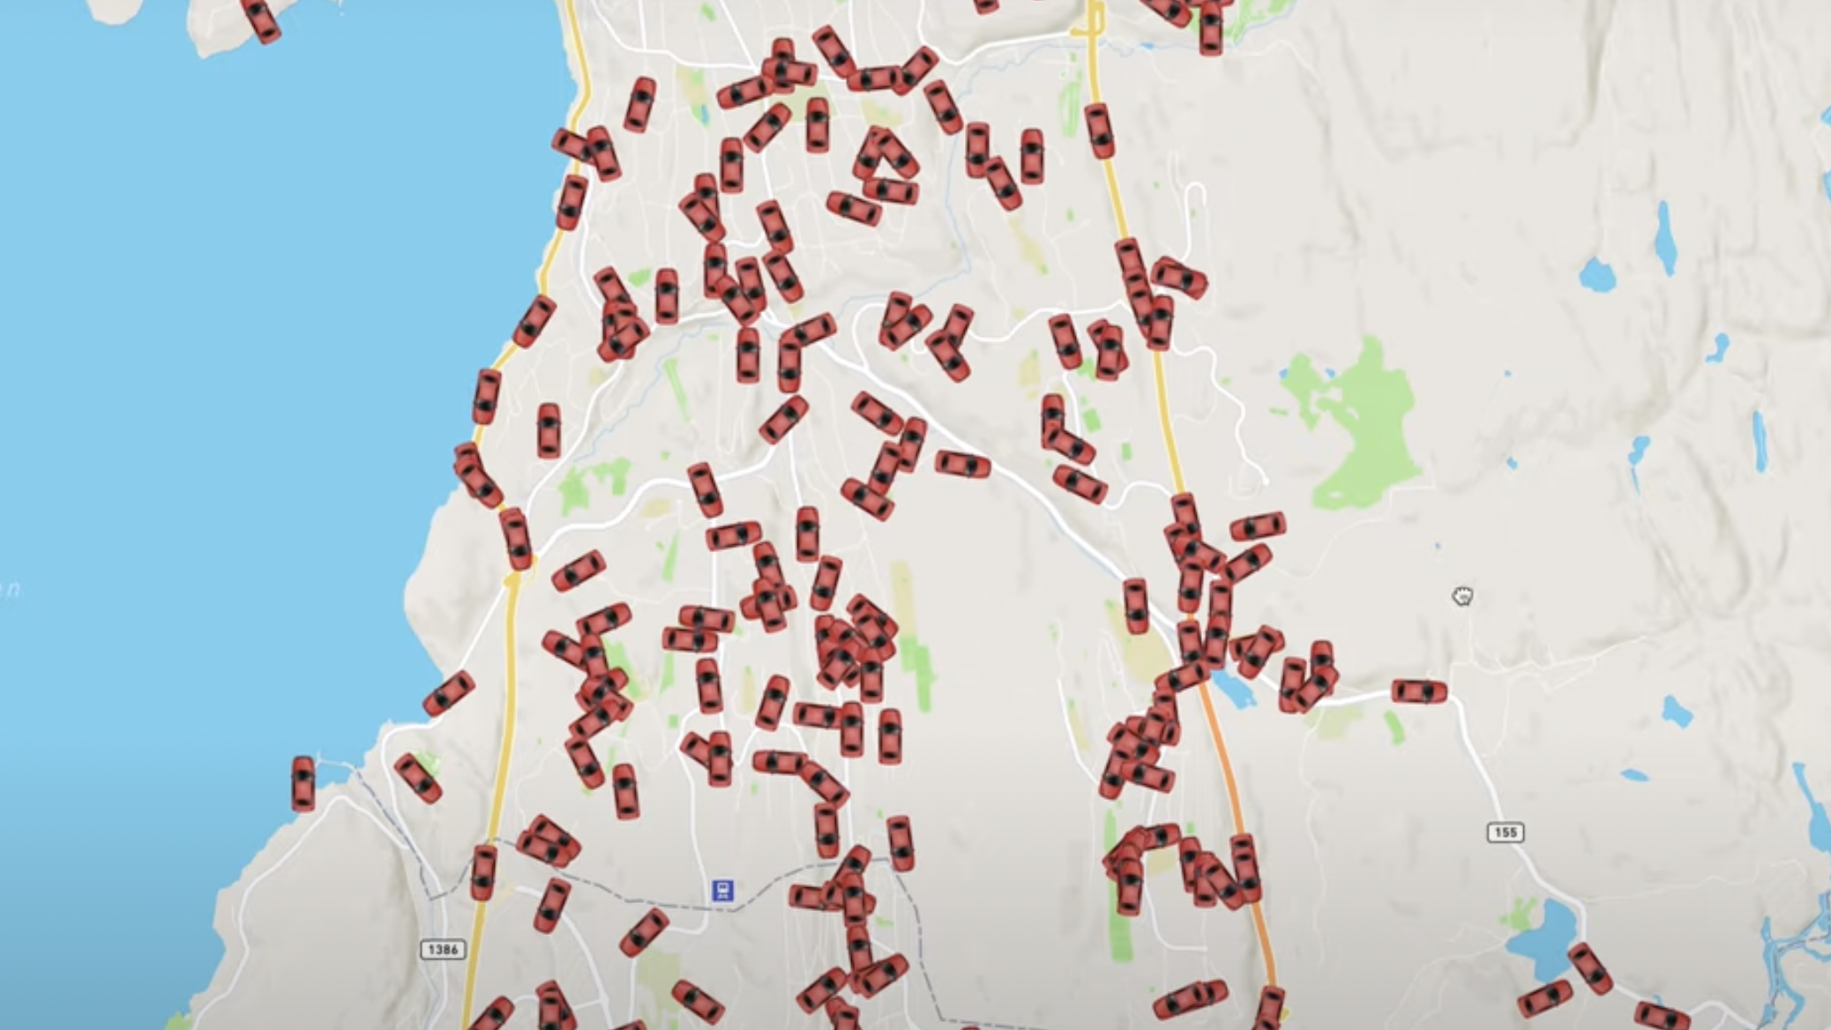

Slide 33
Solution: Viewports
(This idea was scrapped in favor of a simpler solution.
It is still a very effective solution worth mentioning)

Slide 34


Slide 35
Challenge: Maintainability, actors are hard
Solution: Typed Actors

Slide 36
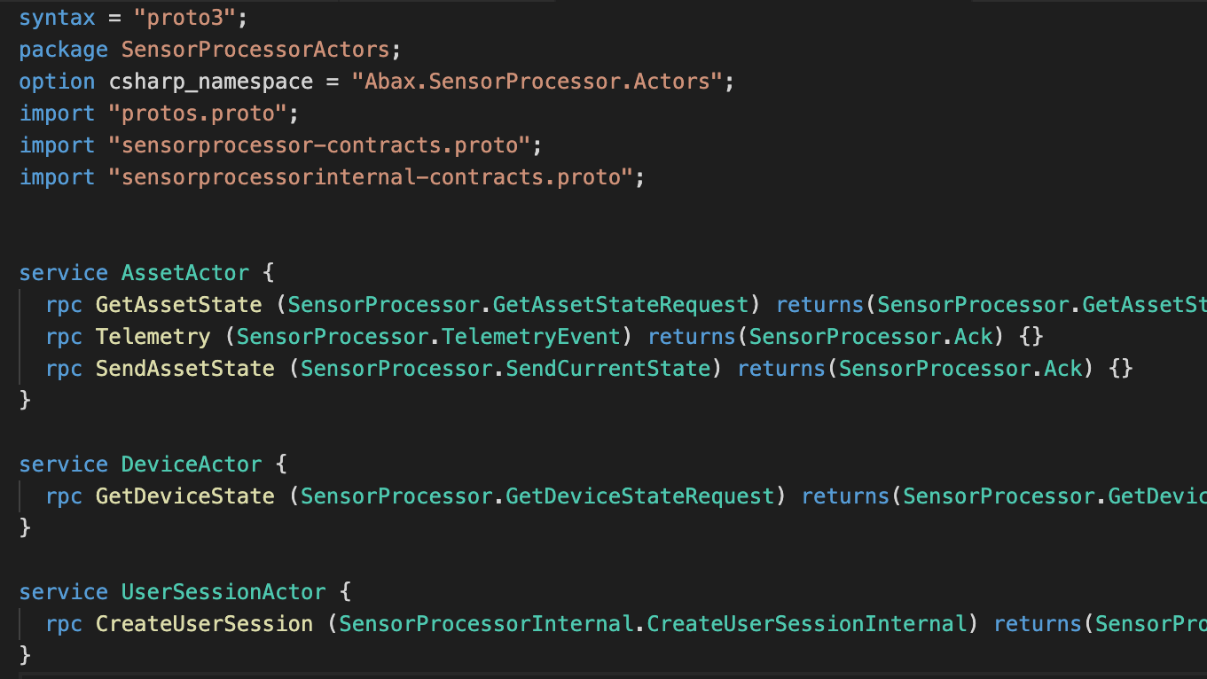

Slide 37
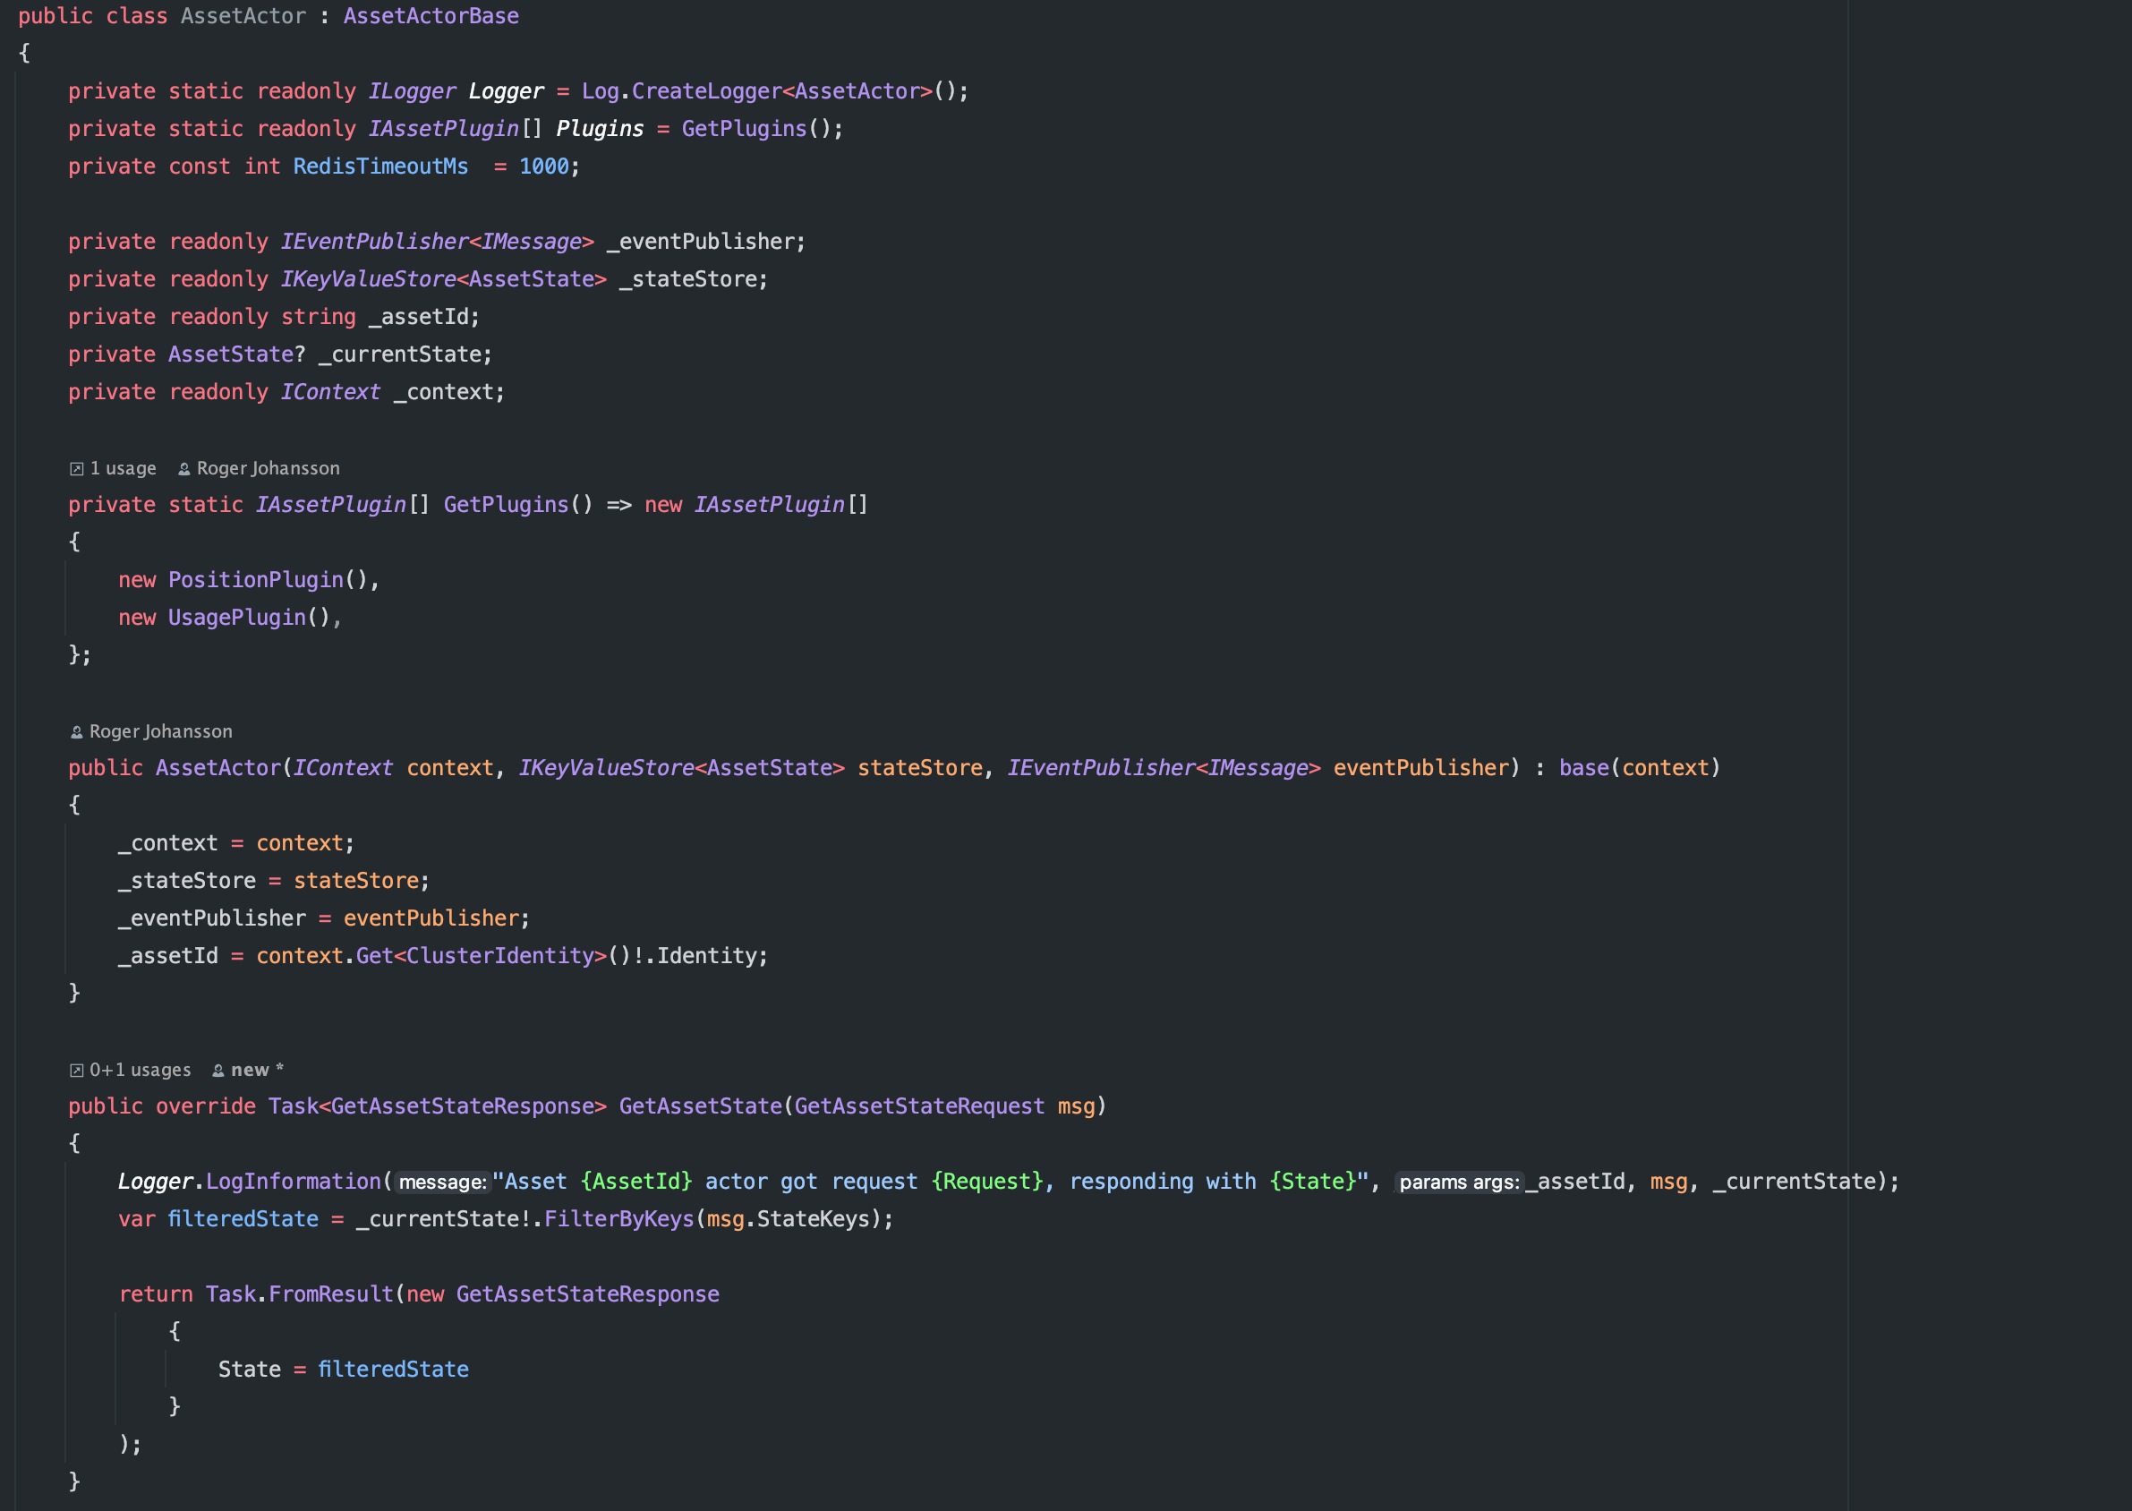

Slide 38
Challenge: Extensibility Solution: Plugins

Slide 39
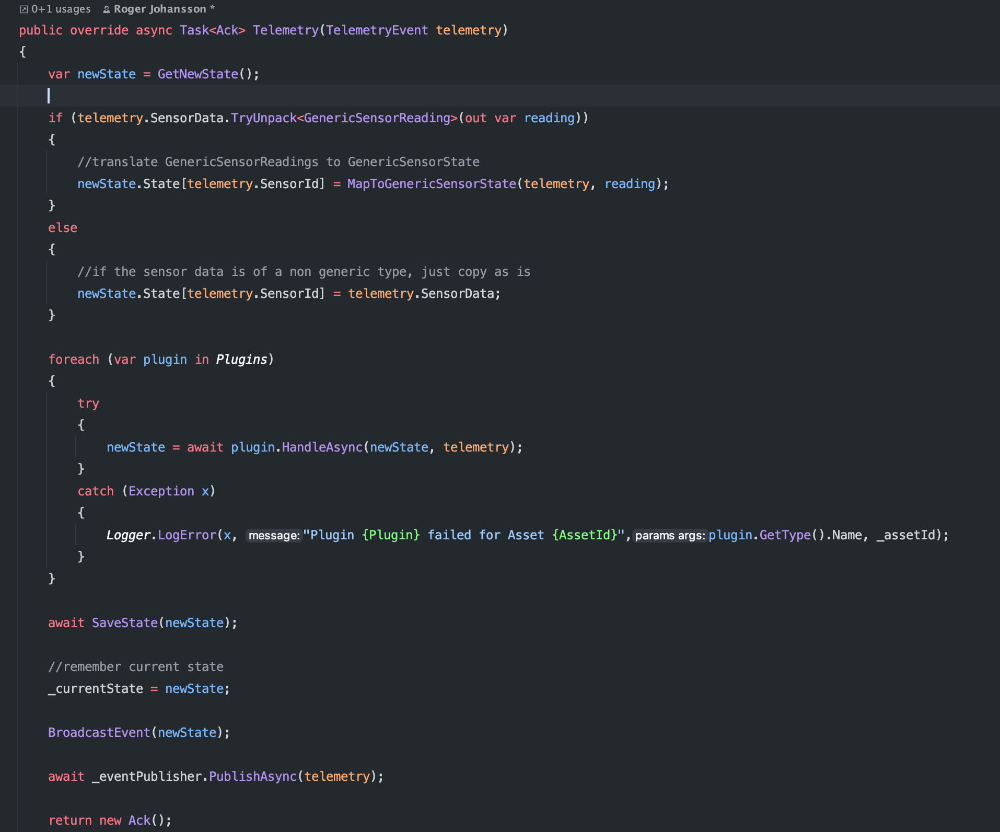

Slide 40
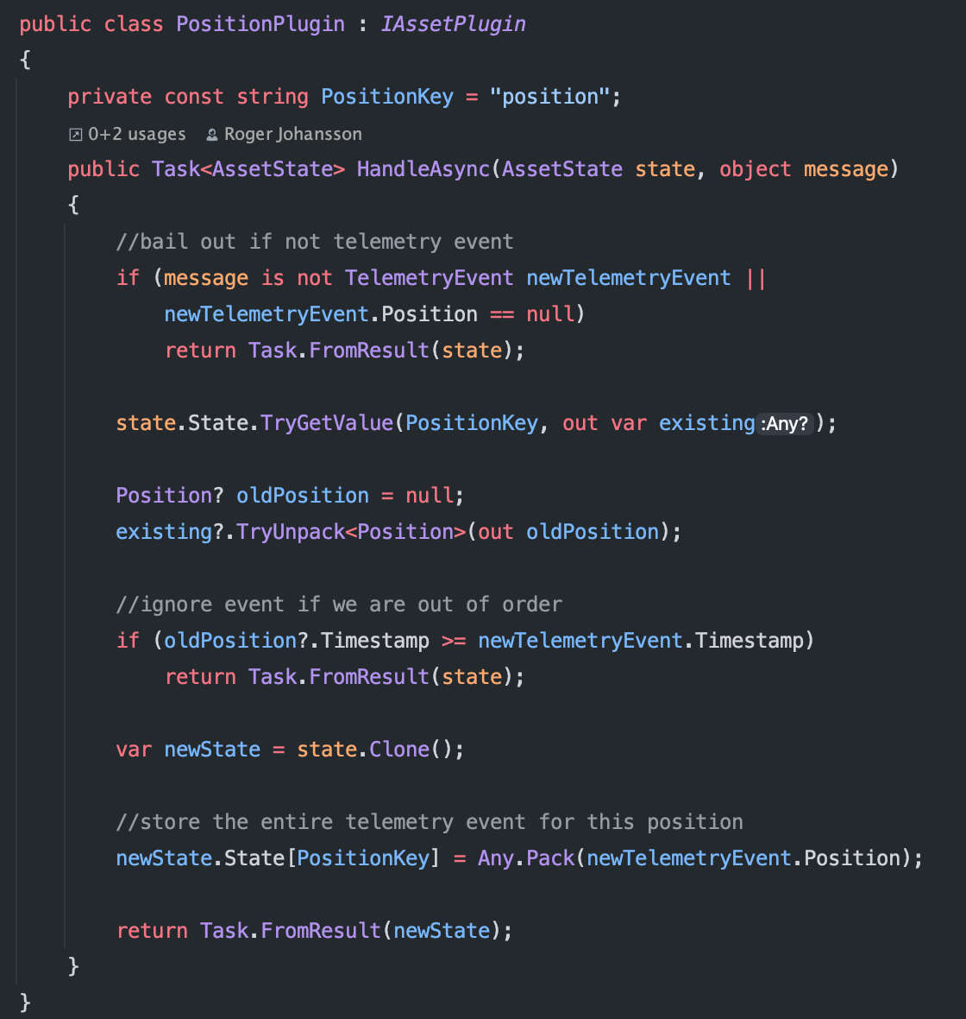

Slide 41
Diagnostics

Slide 42
API – Get State

Slide 43
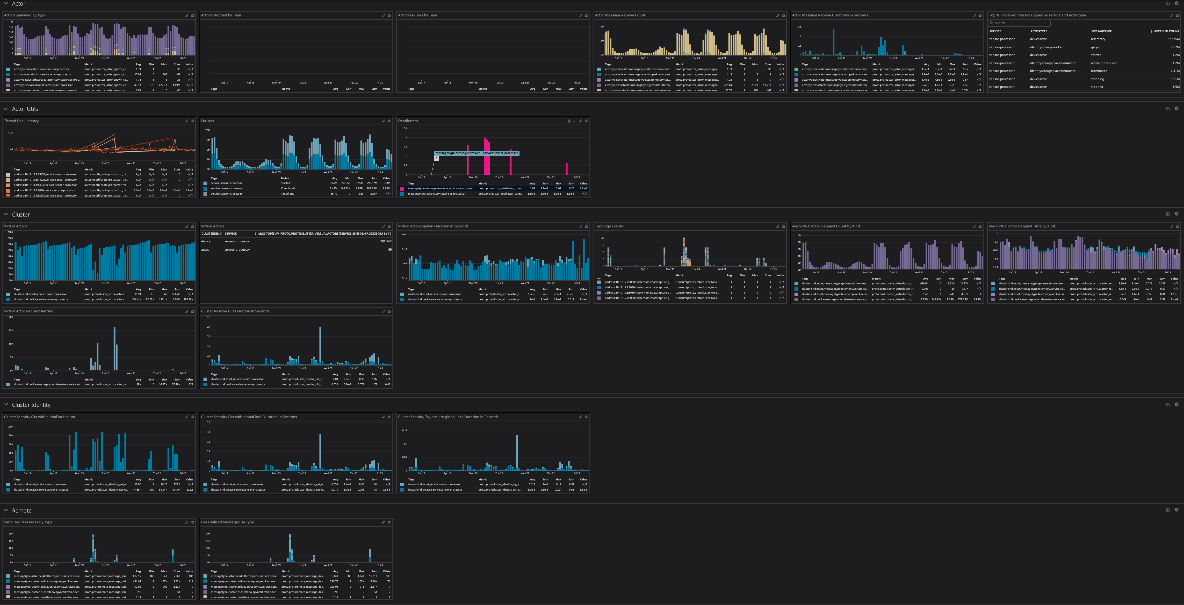

Slide 44
Unsolved Problems?

Slide 45
Realtime vs Durability

